Slide 1
STUDENT PROJECT · WEB APPLICATION
VEHICLE
SERVICE
MANAGEMENT
A connected MERN system for customers, vehicles, and service history
Notes:
Introduce the project as a practical web application for keeping vehicle service information together. Preview the system story: records, data relationships, APIs, authentication, and future operations.

Slide 2
SERVICE RECORDS ARE DIFFICULT TO TRACK CONSISTENTLY
THE OPERATIONAL PROBLEM
01
Details become scattered
Vehicle and customer information can sit across paper files or disconnected spreadsheets.
02
History takes time to retrieve
Service dates, work performed, and cost history are difficult to find quickly.
03
Operations lose visibility
A centralized system can make service operations easier to manage.
Notes:
Frame the challenge as a consistency and retrieval problem. The goal is not simply to store more information, but to make the full service history available when staff need it.

Slide 3

THE PROJECT BRINGS THE FULL SERVICE RECORD INTO ONE SYSTEM
ONE RECORD · THREE OPERATING MOVES
01
02
03
Manage
Track
Maintain
Customers, vehicles, service entries, dates, and costs live together.
Complete vehicle service history remains available over time.
Add, view, update, and manage relevant records as work changes.
Notes:
Show the system as a single source of truth. The three moves are simple: manage the entities, track the history, and keep the records current as service work continues.

Slide 4
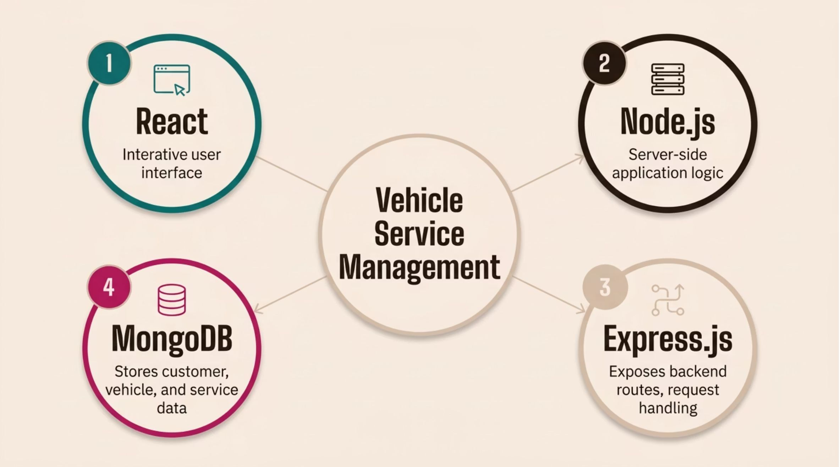
APPLICATION FOUNDATION
MERN
Four technologies, one connected web application.
CLIENT · SERVER · DATA
Notes:
Explain that MERN provides the technical foundation. React handles the interface, Node.js and Express.js support the server and routes, and MongoDB stores the application data.

Slide 5

THE DATA MODEL CONNECTS CUSTOMERS, VEHICLES, AND SERVICE EVENTS
THE RECORD RELATIONSHIP
Each relationship gives the service history a clear place to live and makes related information easier to retrieve.
Vehicles
Each vehicle can have multiple service records.
Customers
Service events
One customer can have one or more vehicles.
Date, work details, and cost are captured together.
Notes:
Walk from the customer to the vehicle, then from the vehicle to its service events. This relationship is the core of the data model: one customer may have several vehicles, and each vehicle can accumulate many records.

Slide 6
REST API LIFECYCLE
01
02
CRUD KEEPS RECORDS CURRENT
Create
Read
Add a customer, vehicle, or service record.
Retrieve service history and related details.
Each operation maps to a practical action in the management workflow.
CREATE · READ · UPDATE · DELETE
03
04
Update
Delete
Correct or change information as needed.
Remove or manage records that are no longer needed.
Notes:
Connect the four CRUD actions to the REST API lifecycle. Every operation supports a record at a different point in its useful life, from creation through maintenance and eventual removal.

Slide 7



AUTHENTICATION PROTECTS ACCESS TO SERVICE DATA
ACCESS CONTROL
Sign in first
Separate roles
Protect APIs
Users sign in before accessing management features.
Role-based access can separate administrator and staff permissions.
Protected APIs help keep customer and vehicle information controlled.
Notes:
Authentication creates the boundary around the service data. Users sign in first, roles can separate responsibilities, and protected APIs help control access to customer and vehicle information.

Slide 8

PROJECT OUTCOME
THE RESULT IS A SCALABLE BASE FOR BETTER SERVICE OPERATIONS
Demonstrates MERN stack development in a practical workflow
Shows MongoDB CRUD operations through Node.js and Express.js APIs
Provides a React interface for clear project information and results
Future scope: service reminders, reports, billing, and analytics
Notes:
Close by connecting the technical work to its operational value. The system already demonstrates the core workflow, while reminders, reports, billing, and analytics provide clear directions for future development.

